Slide 1
RTC of Southern Nevada:
We put the ‘fun’ in Funding

Slide 2

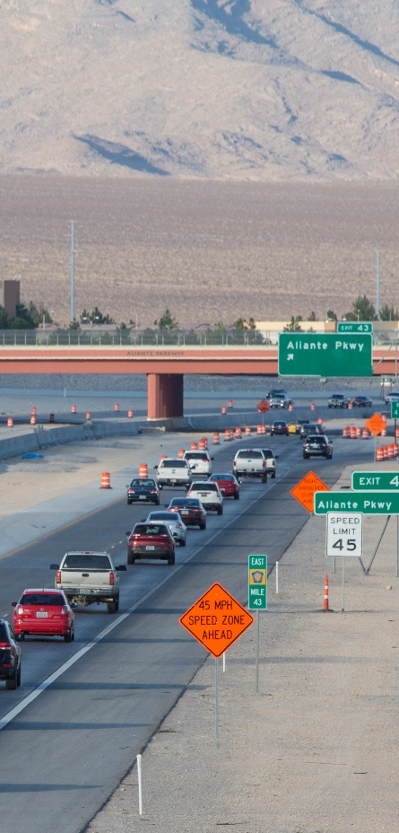
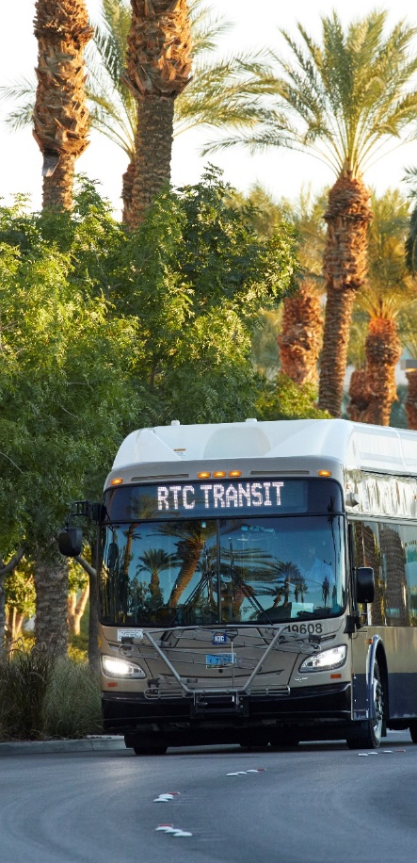
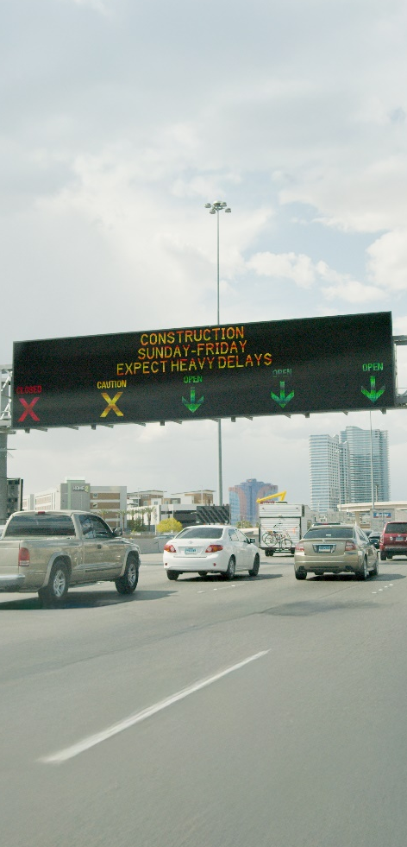
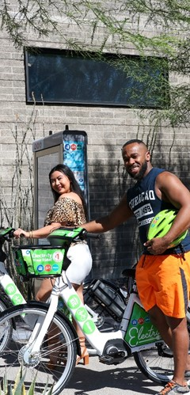
What We Do
Planning
Roadway
Funding
Transit
Traffic Management
Bicycling

Slide 3
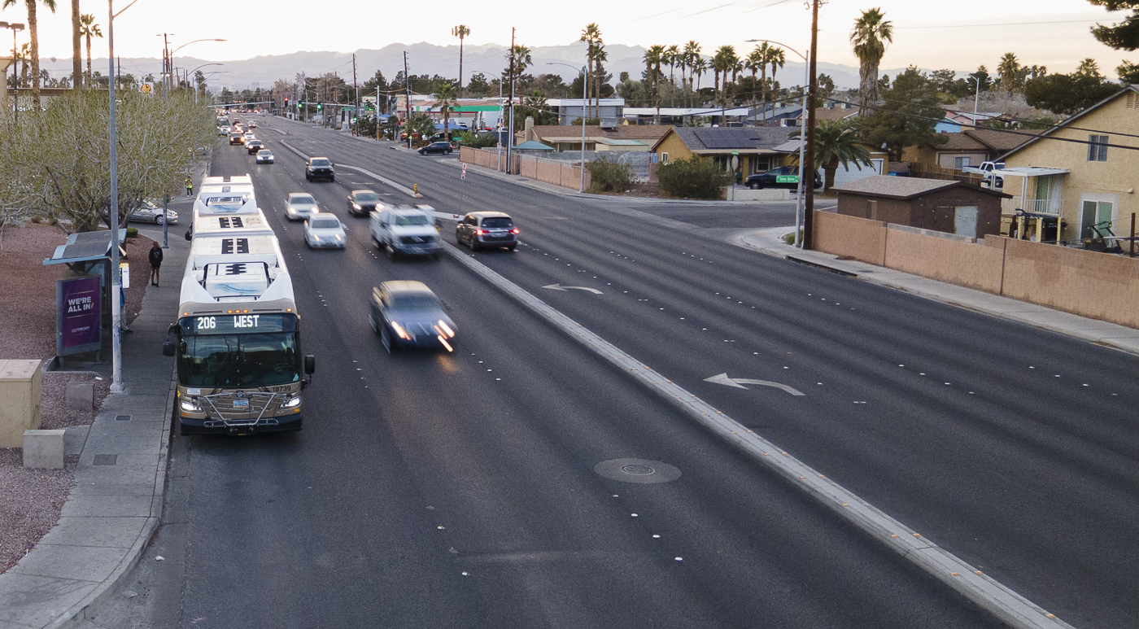
Transit
Funding

Slide 4


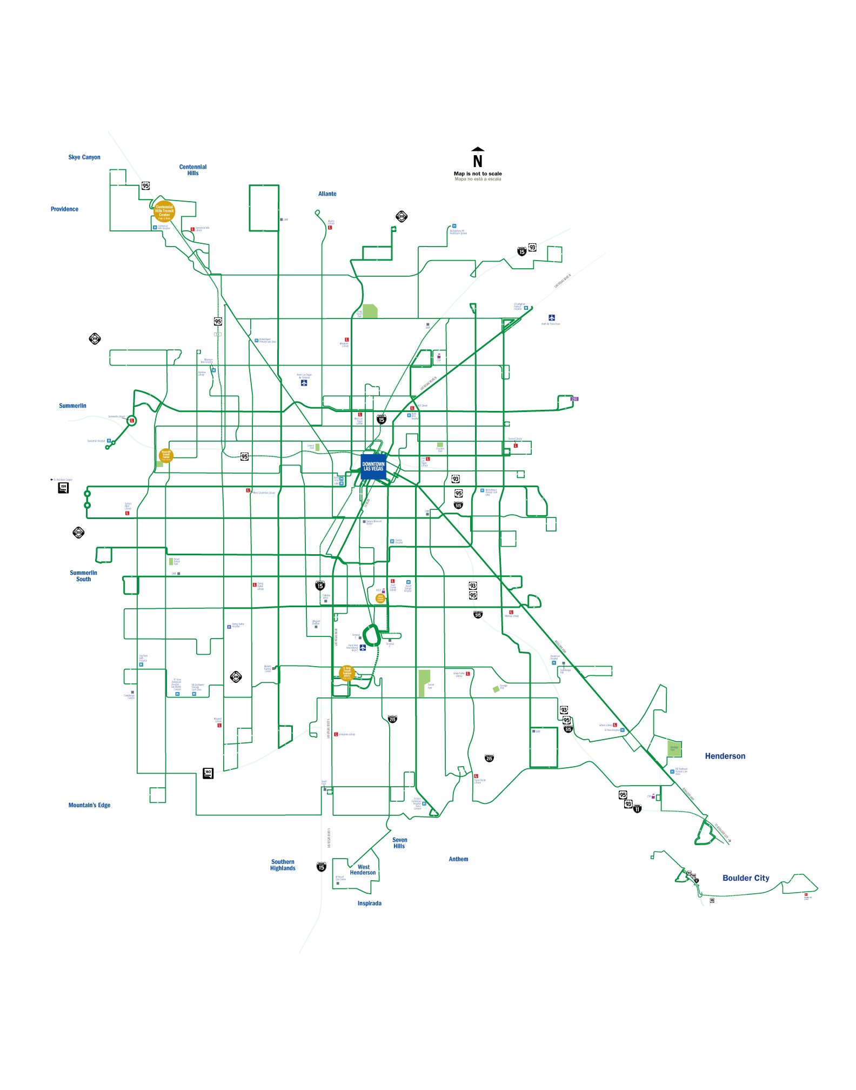
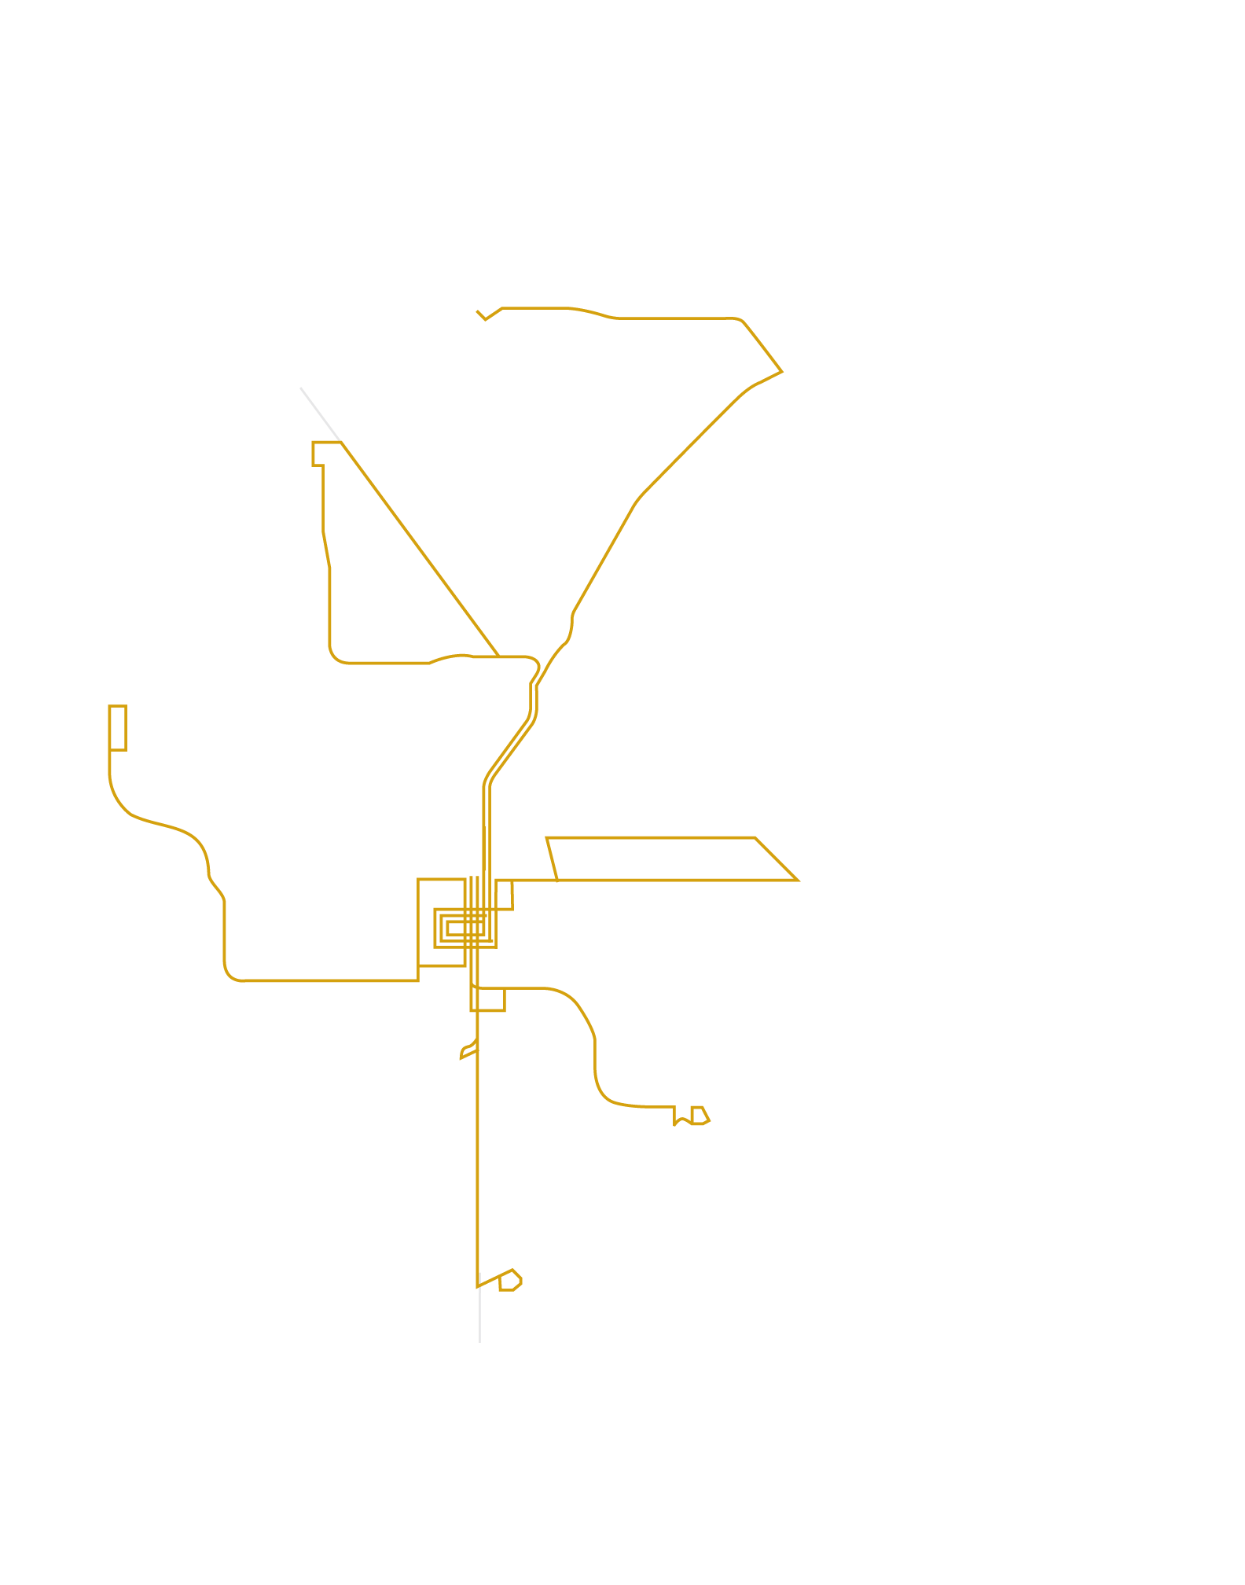
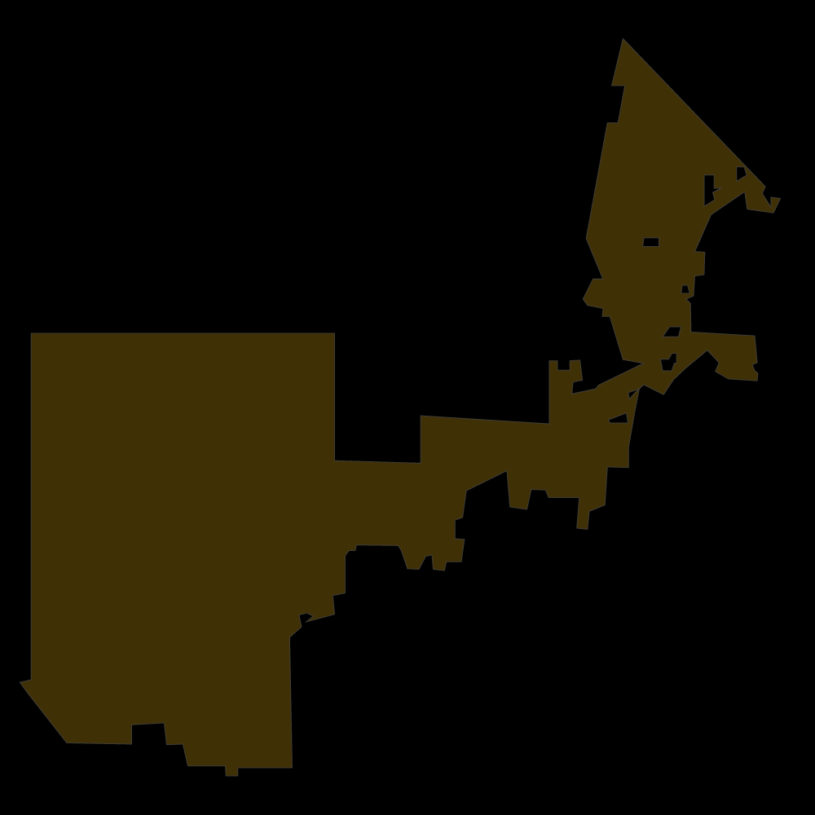










Transit
System
Map
City of North
Las Vegas
Nellis AFB
City of Las Vegas
Clark County
T-Mobile Arena
Allegiant Stadium
City of Henderson
Boulder City

Slide 5
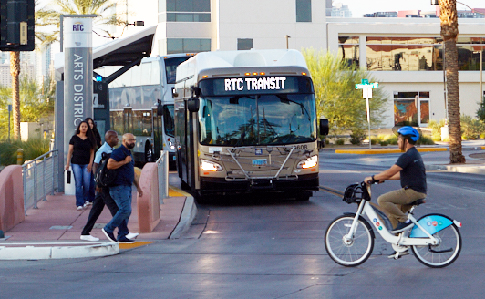
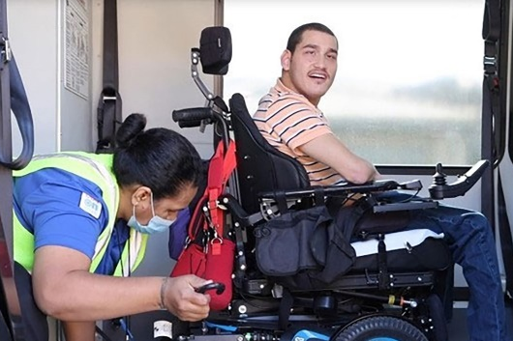
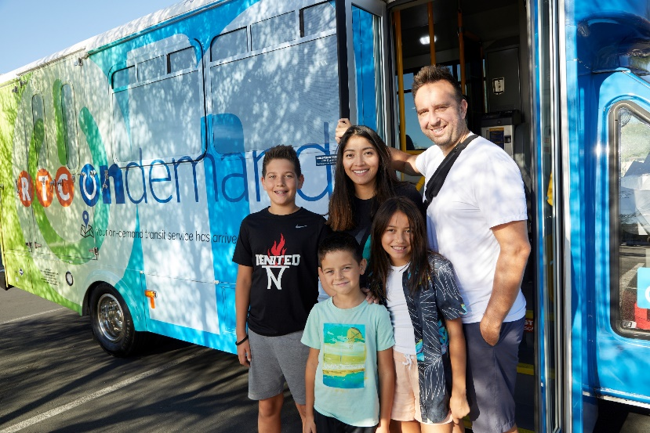


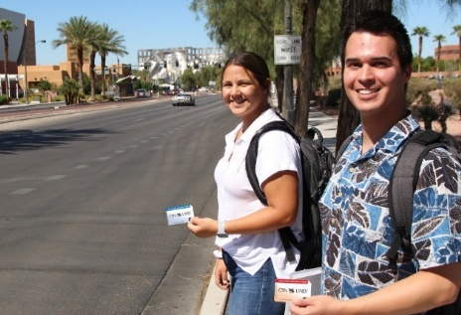
Mobility Services
  Transit
  Paratransit
  OnDemand
  Senior
  Veterans
Students

Slide 6
How Transit is Funded
$85,204,231
$239,226,390
$70,939,125
$24,622,404

Slide 7
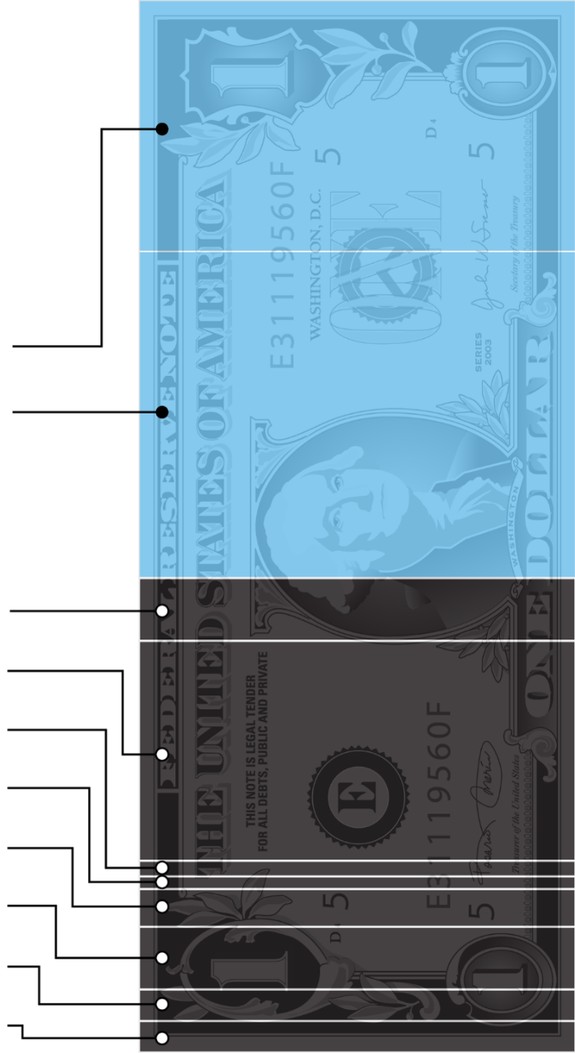
Retail Sales Tax Allocation
State Sales Tax (General Fund)
2.000%
Local School Support Tax
2.600%
TRANSIT
Basic City-County Relief Tax
0.500%
8.375%
Supplemental City-County Relief Tax
1.750%
State Education Fund
0.125%
Police Officers
0.100%
Police Support
0.300%
Regional Transportation
0.500%
Southern Nevada Water Authority
0.250%
Flood Control
0.250%
Source: Nevada Department of Taxation; Applied Analysis

Slide 8
Per Capita Investment In Transit
2023 | Total Expenditures
$91 to $351 Greater Per Capita Spending by peer Agencies on Transit
Source: Federal Transit Administration; Applied Analysis. Note: Locations included large western metros most similarly positioned to RTC Southern Nevada. Florida locations were included because of the similarity of the tourism economy to Nevada. Population refers to service area population.

Slide 9
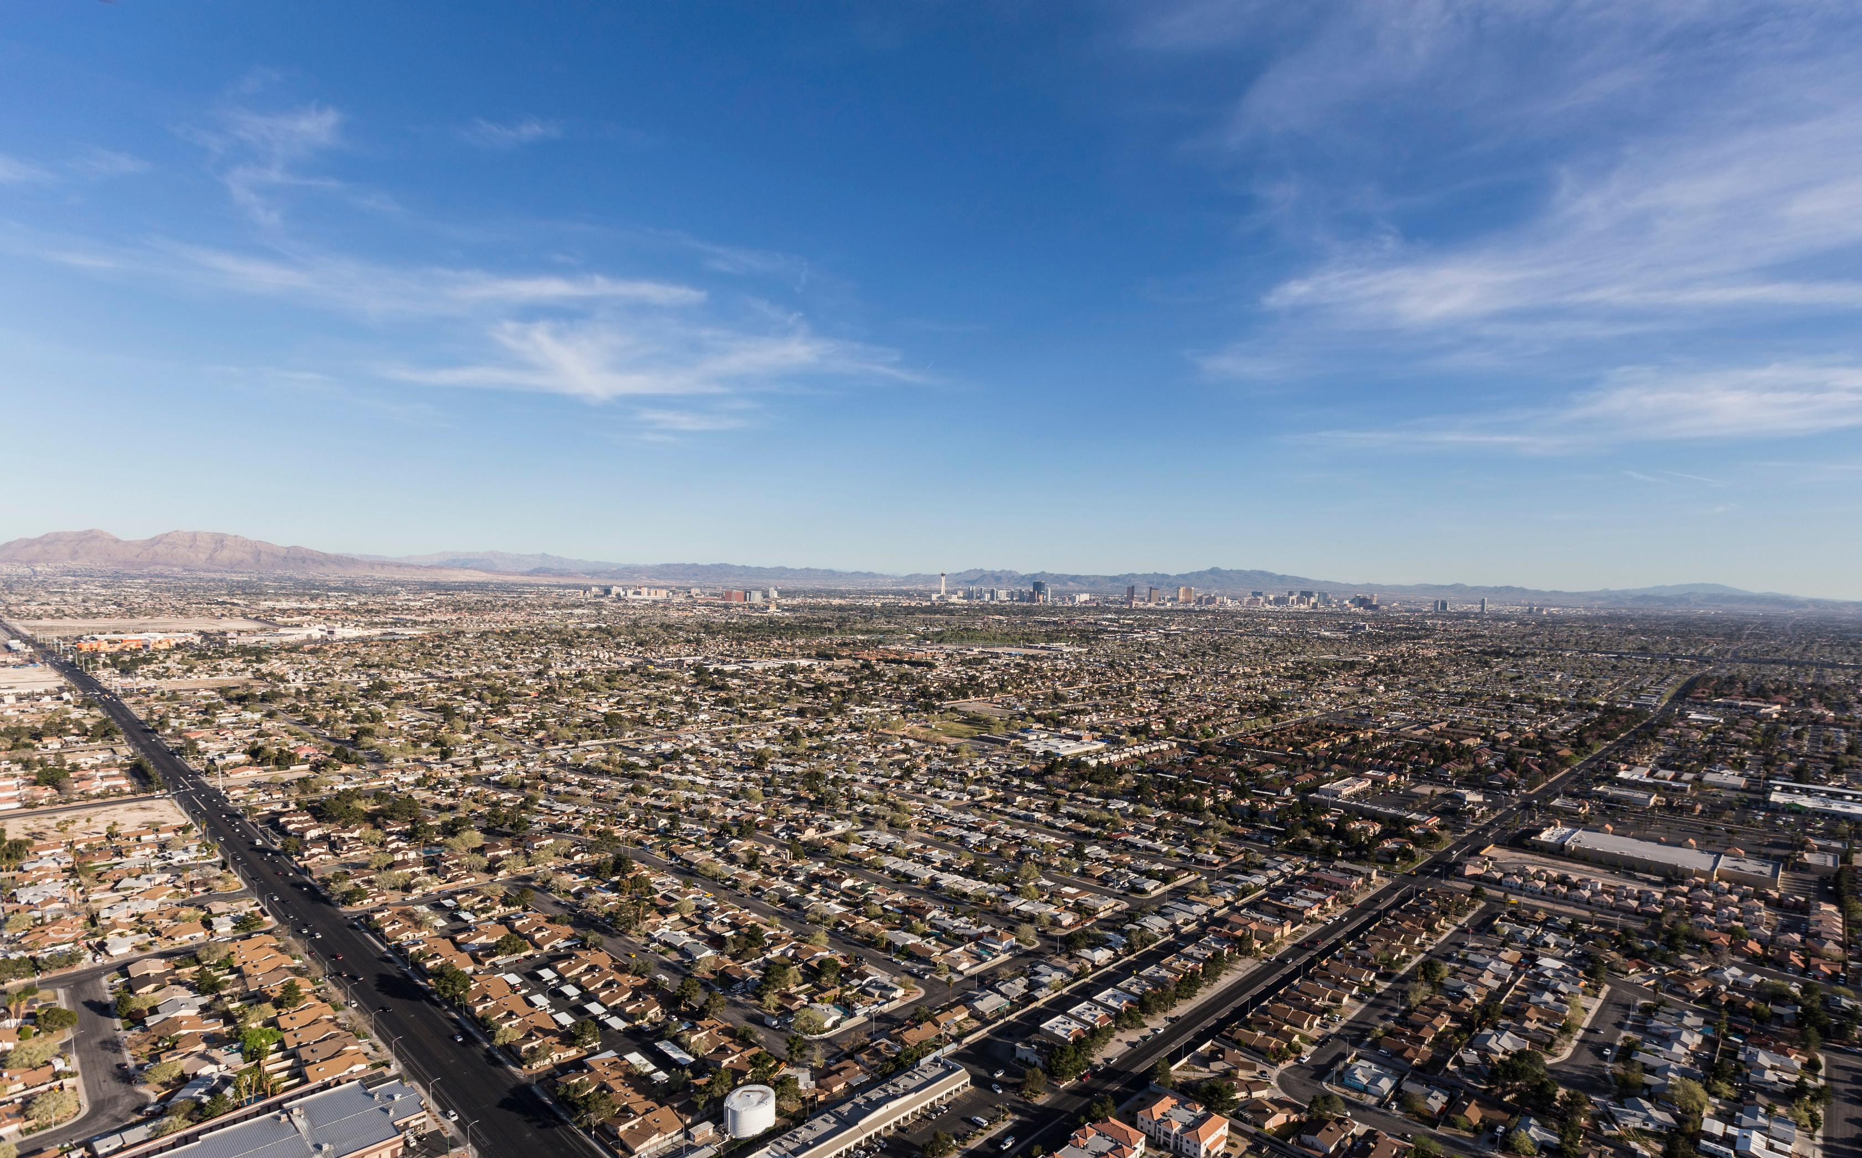
The RTC is Currently One of the Most Efficient Transit Agencies in the Nation
  #1
  Lowest
  Cost per
  Passenger Trip
  #1
  Highest
  Farebox
  Recovery Ratio
  #1
  Lowest
  Subsidy
  12th
  Busiest
  Bus System
Source: National Transit Database (latest available data)

Slide 10

RTC Cash Balance – Transit

Slide 11
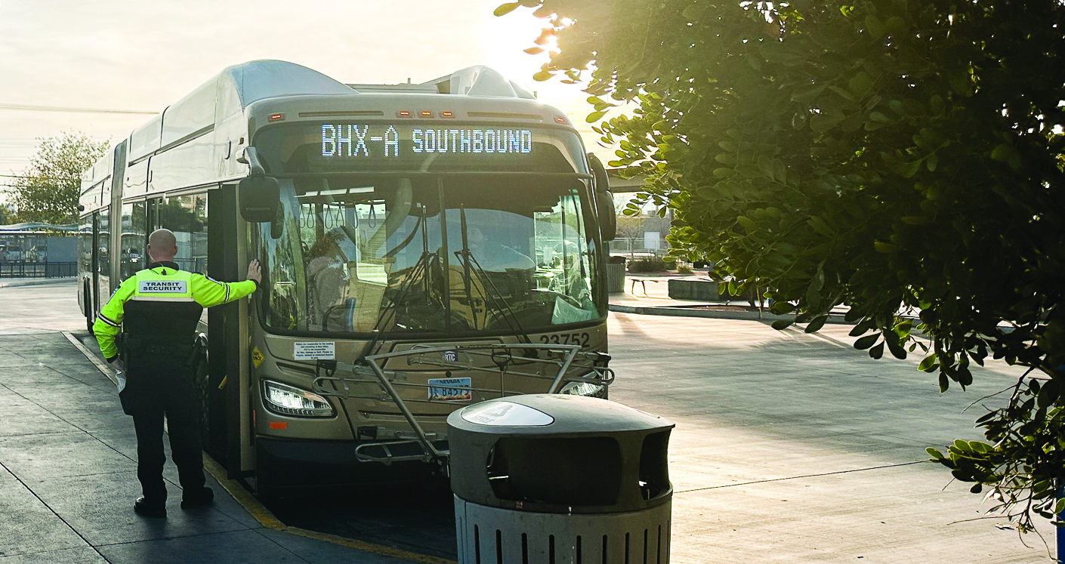
Funding Challenges
Demand
Passenger Fare Revenue
Sales Tax Revenue
Labor Costs
Inflation/Supply Chain

Slide 12
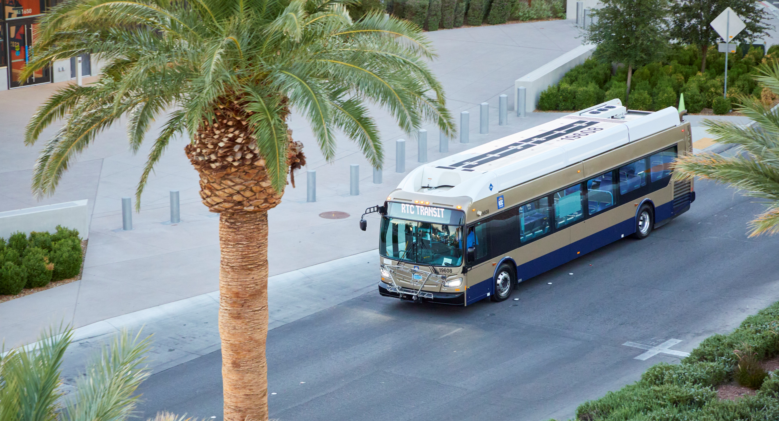

Assembly Bill 28
Transit Funding
Ballot Authority
C

Slide 13
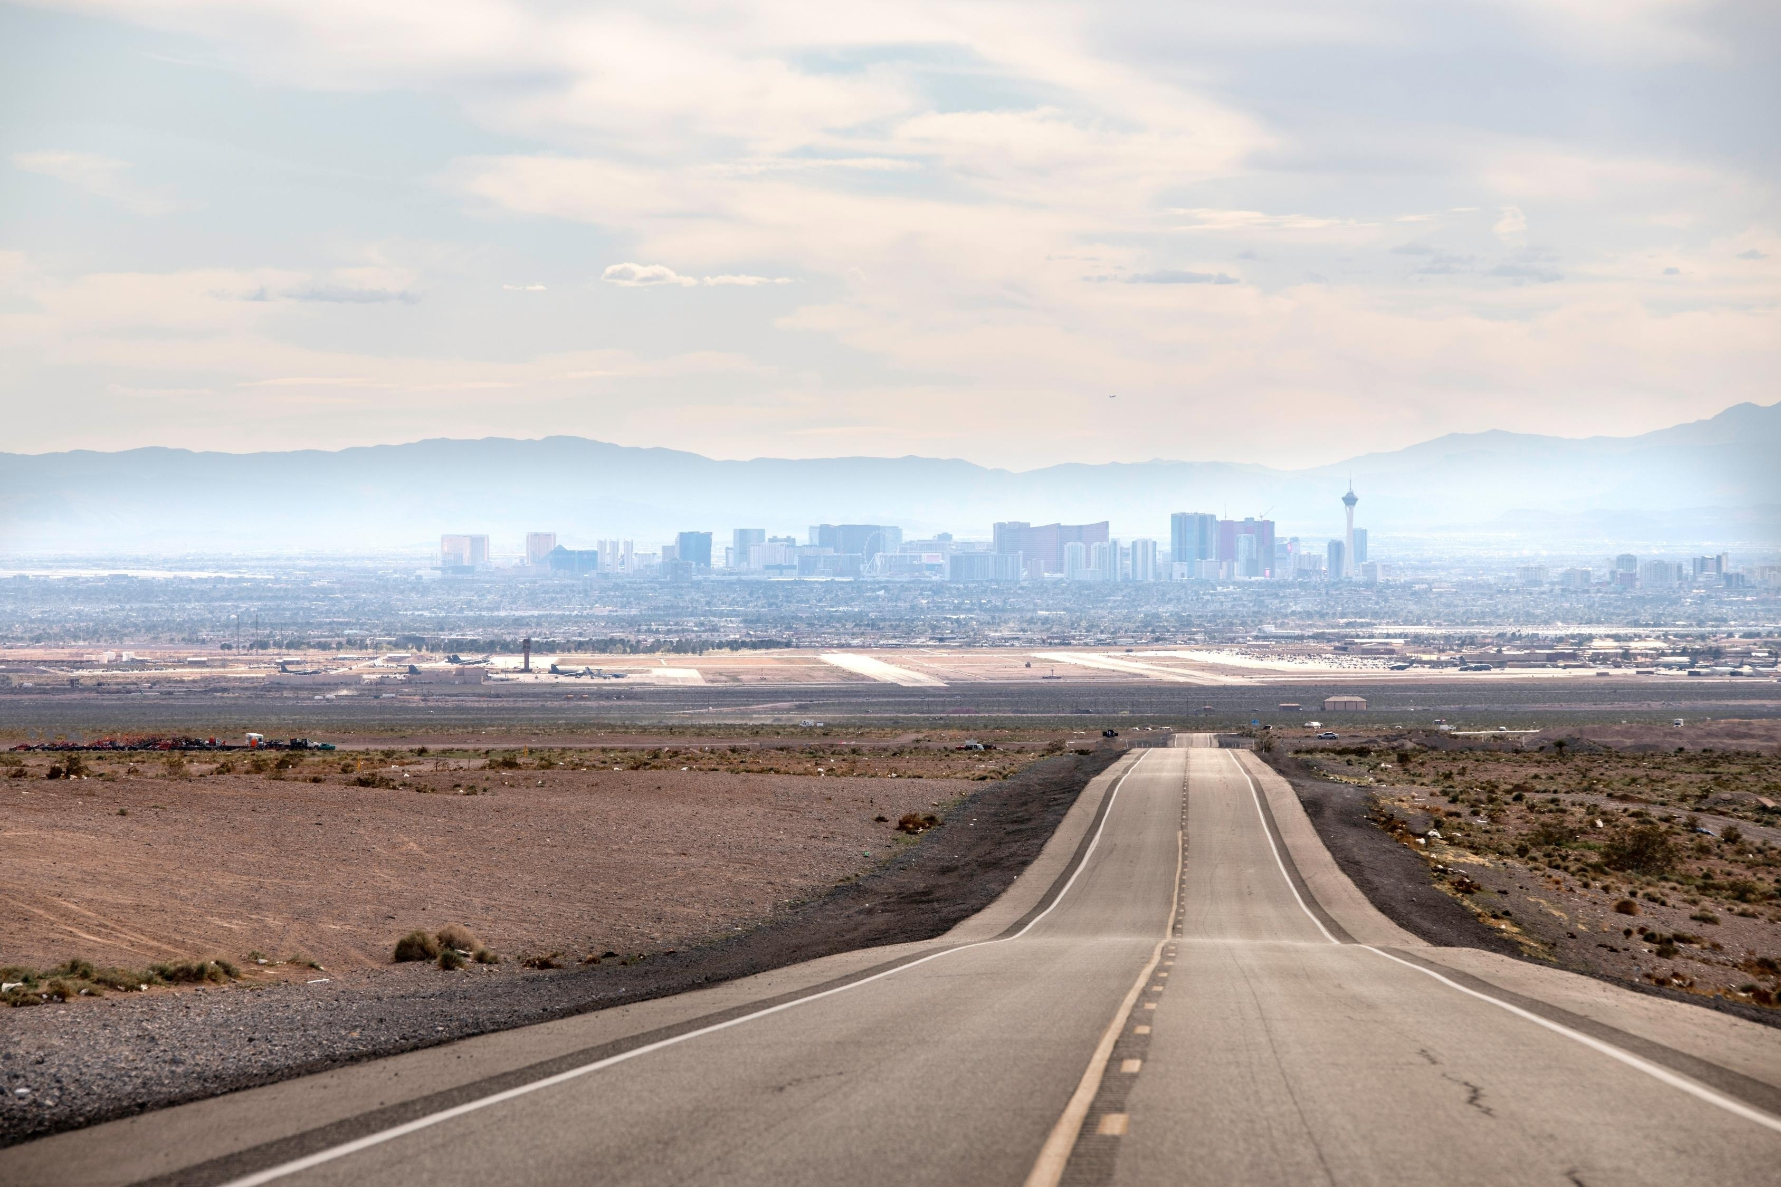
Roadway Funding

Slide 14
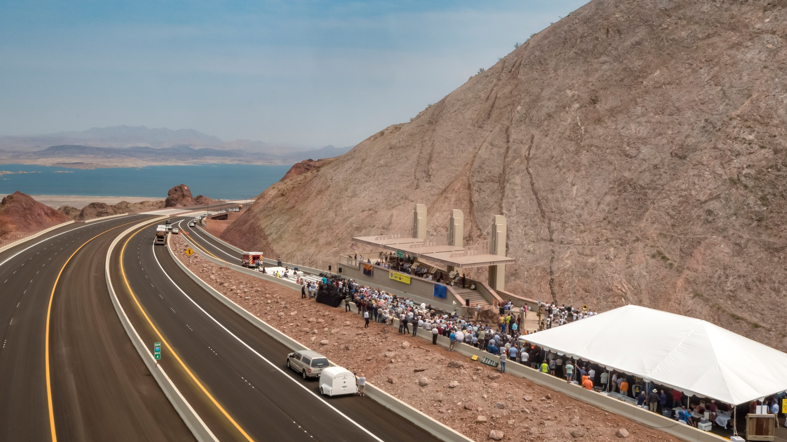



How Roads Get Funded
  Motor Vehicle
  Fuel Tax (MVFT)
  Sales Tax
  (Q10)
  Fuel Revenue
  Indexing
  (FRI)

Slide 15

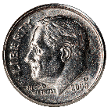
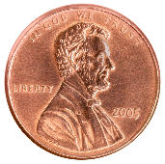
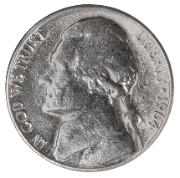
Fuel Tax Breakdown
How Much Have We Collected?
Despite rising gas prices, we collect 75 cents in taxes.
24.6 cents goes to the RTC
9 cents goes to the county
23 cents goes to the state
18.4 cents goes to the federal government

Slide 16
RTC Fuel Tax Collections
Actual
While Motor Vehicle
Fuel Tax revenue has
remained flat for
more than a decade,
Fuel Revenue Indexing (FRI) has generated
more than $1 Billion to help fund
critical roadway projects.
Source: Regional Transportation Commission. Totals include revenue for gasoline and special fuels such as diesel.

Slide 17
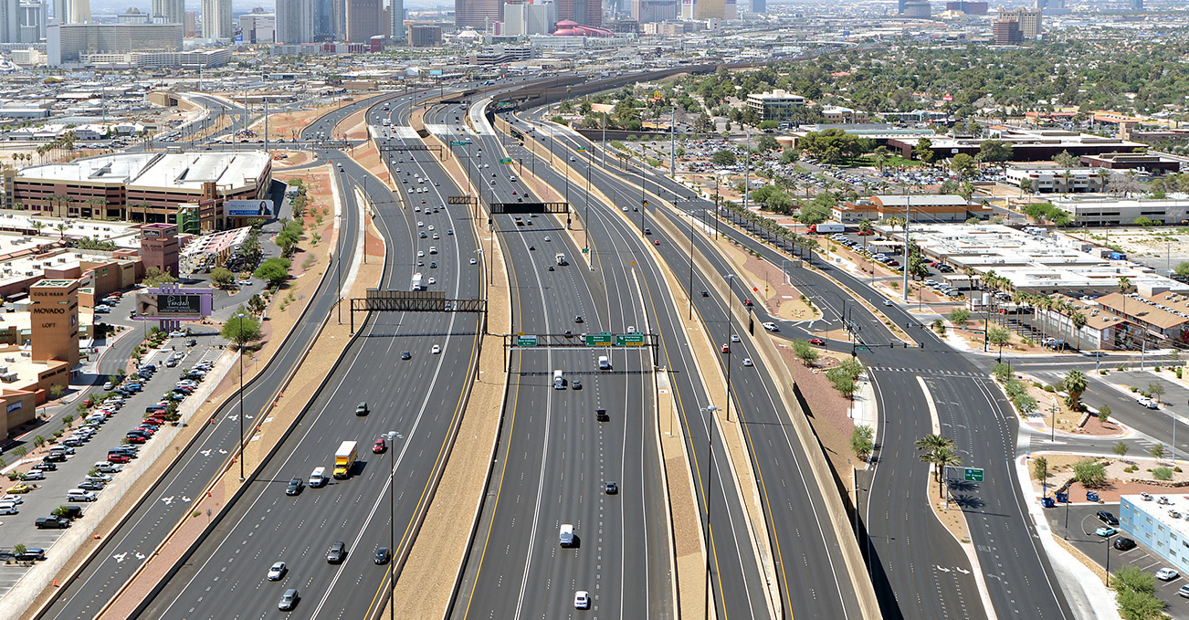





Fuel Revenue Indexing
Progress report as of April 2025
702
Projects Awarded
78
Local Small Businesses
$3B
Contracted Amount
22,000
Jobs

Slide 18

Total Projects By Phase All Funds
*3rd Qtr.

Slide 19
Total Dollars Under Contract By Fund
*3rd Qtr.

Slide 20
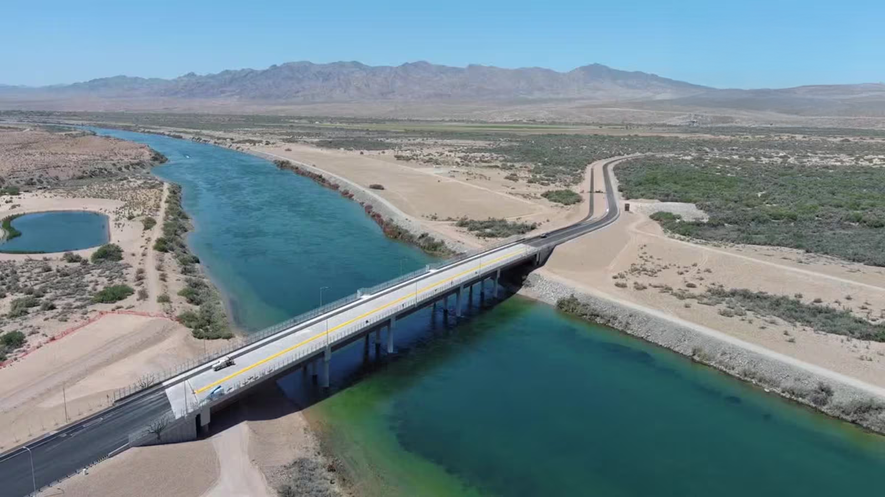
Federal Projects with FRI Local Match
PROJECT | FRI FUNDS | FEDERAL FUNDS | TOTAL
Laughlin/Bullhead Bridge | $30,000,000 | $22,000,000 | $52,000,000
I-15 Interchange at Starr Ave | $38,000,000 | $5,000,000 | $43,000,000
I-11 Boulder City Bypass | $37,000,000 | $239,000,000 | $276,000,000
Maryland Parkway Bus Rapid Transit | $125,000,000 | $219,000,000 | $344,000,000
Reimagine Boulder Highway | $30,000,000 | $89,000,000 | $119,000,000

Slide 21
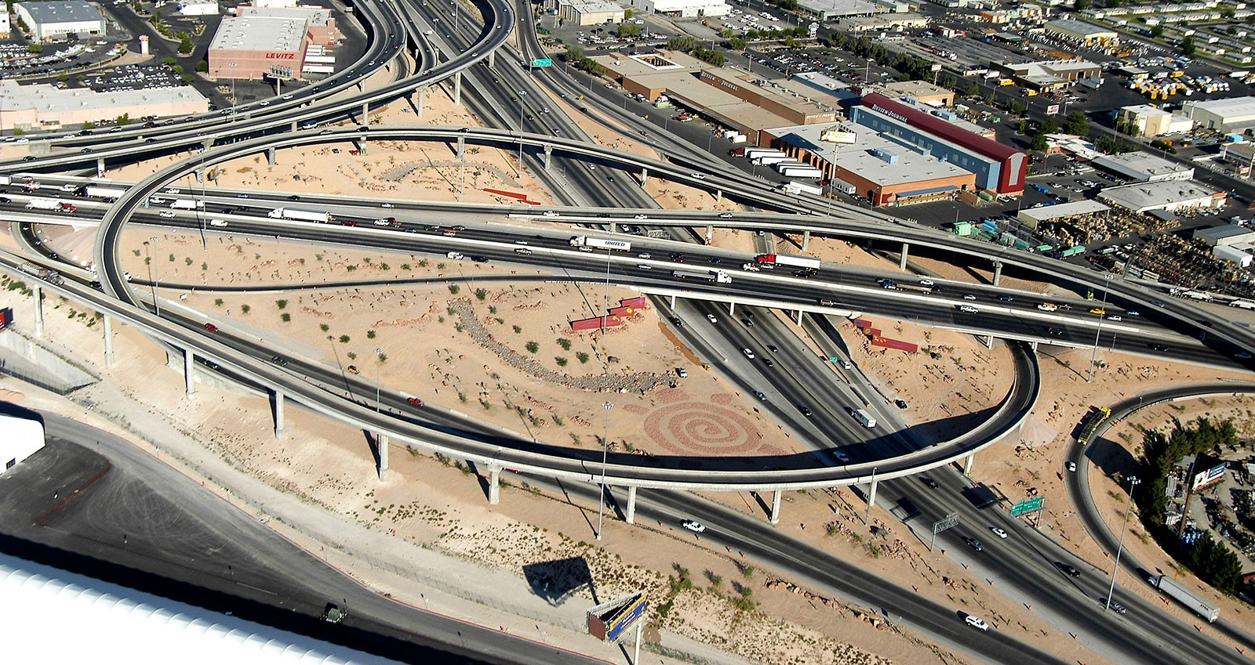
Local Projects with FRI Funding
PROJECT | FRI FUNDS | TOTAL
Las Vegas Blvd Improvements | $173,343,000 | $173,343,000
N. 5th Street Improvements | $105,000,000 | $105,000,000
Main Street Improvements | $55,000,000 | $55,000,000
Boulder City Pkwy | $17,000,000 | $17,000,000
Beltway Improvements | $75,000,000 | $75,000,000

Slide 22
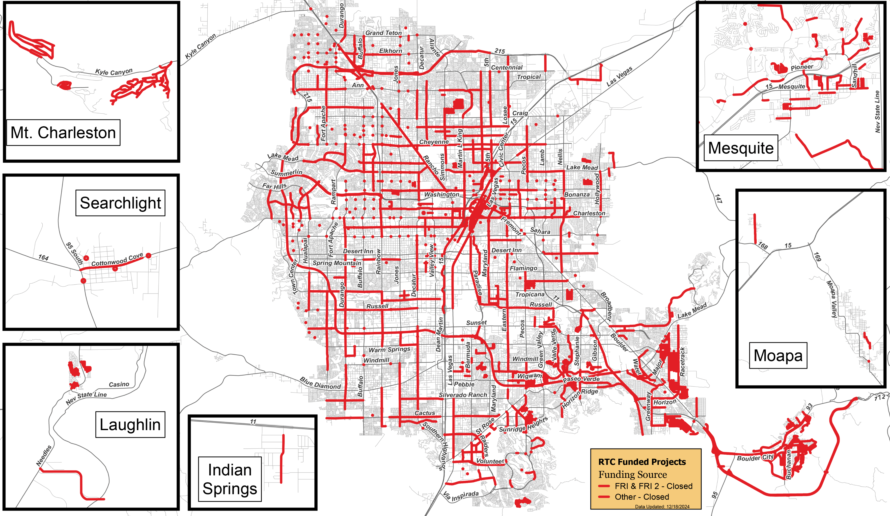
FRI Funded Roadway Projects (1&2)
This information is for display purposes only. No liability is assumed as to the accuracy of the data delineated hereon.

Slide 23
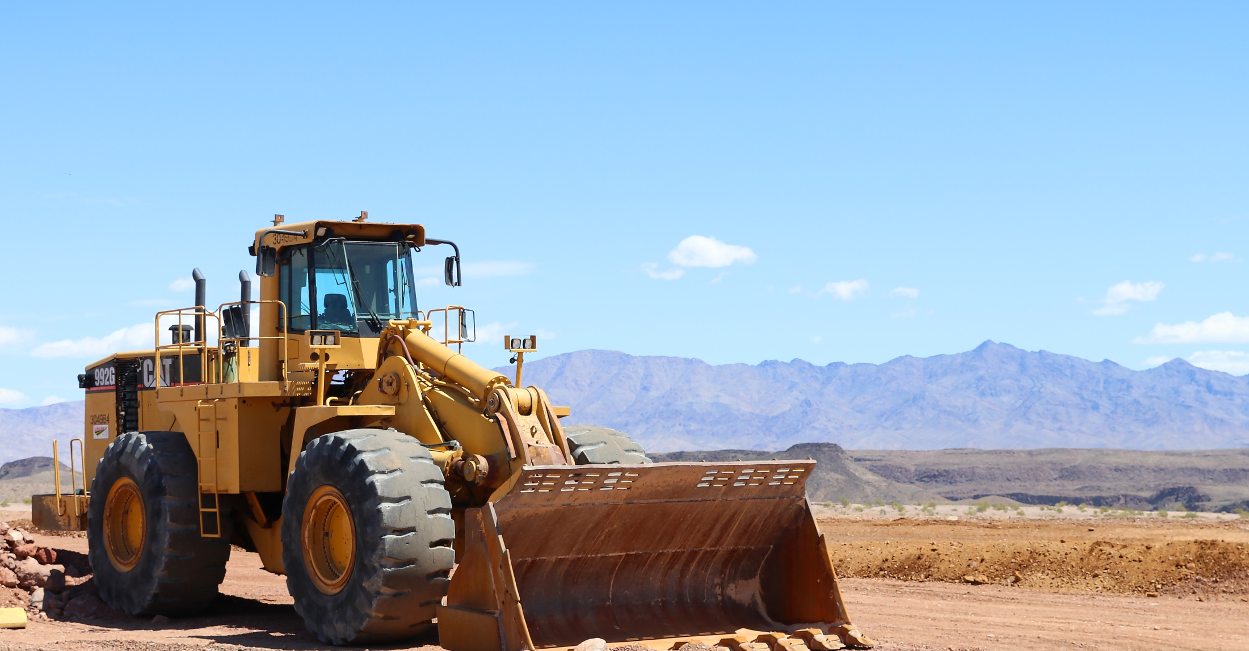

Capital Improvement Program
FY 2025 – FY 2034

Slide 24
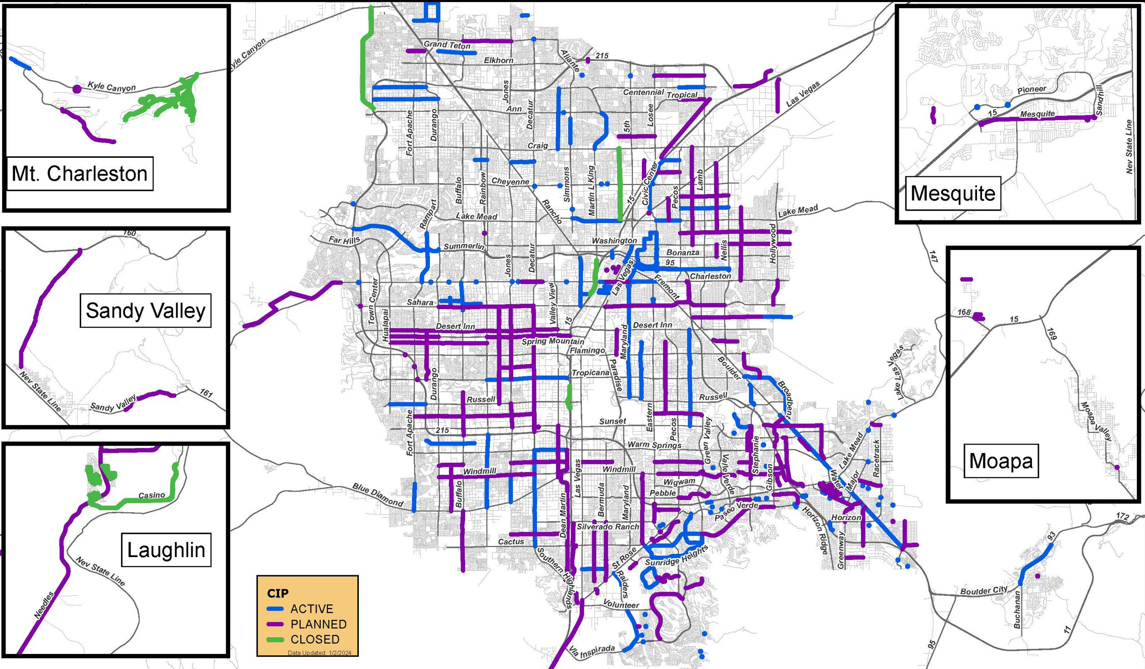
Capital Improvement
Program (CIP)

Slide 25
RTC Cash Balance - Roadways
Baseline

Slide 26
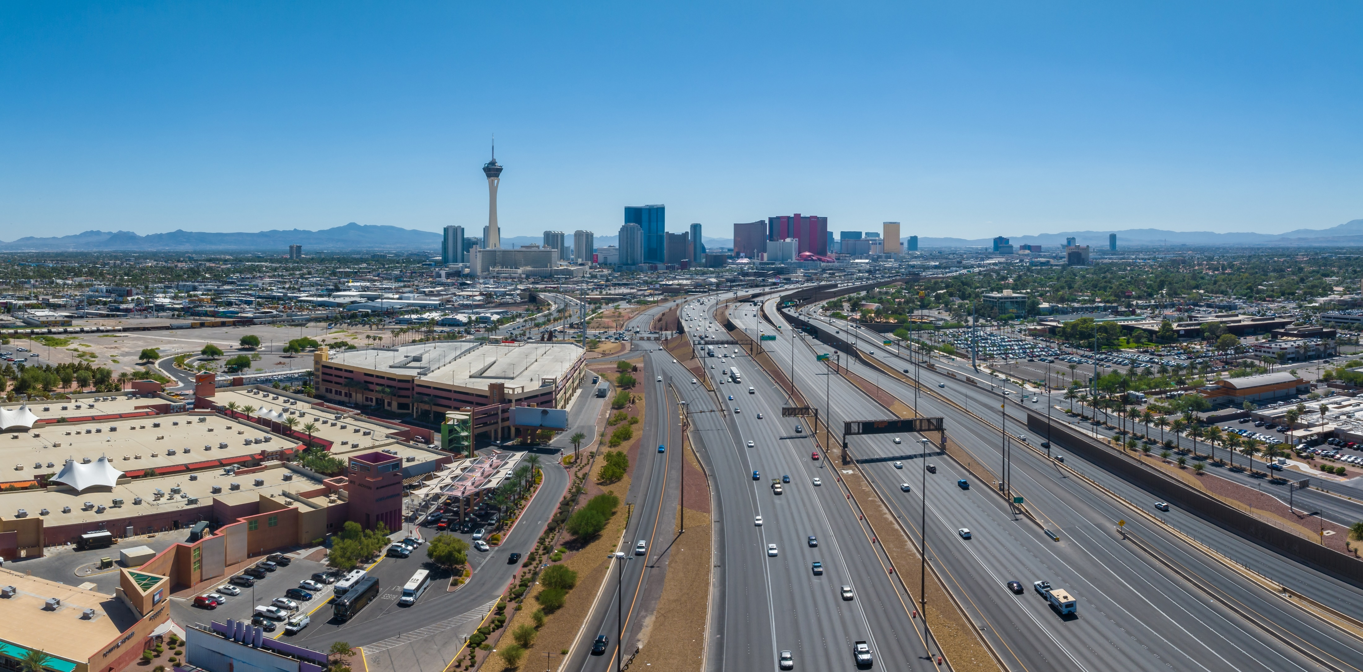



Regional Overview
  42.5M visitors
$100 Million
$300 Million
  2.3M residents
annual roadway
funding
  ±10K miles of roadway

Slide 27


Unfunded Projects
179
Unfunded Projects
$2.7 B
Estimated Project Cost

Slide 28
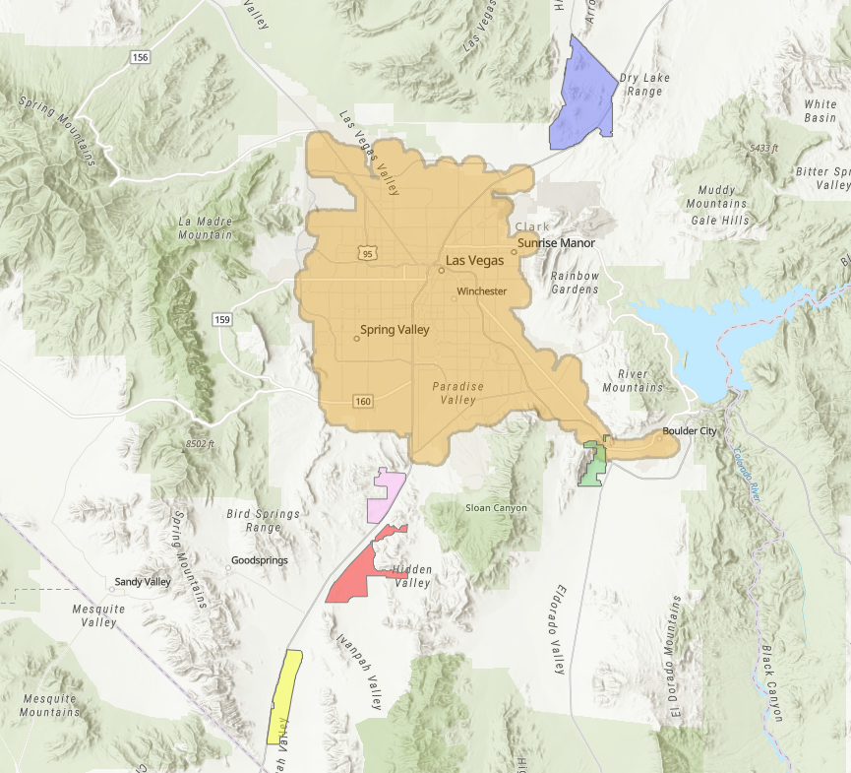
Apex
Future Economic
Development
Current Transit Service Area
Sloan
El Dorado Valley
Snv
Supplemental
Airport
Ivanpah
Valley

Slide 29
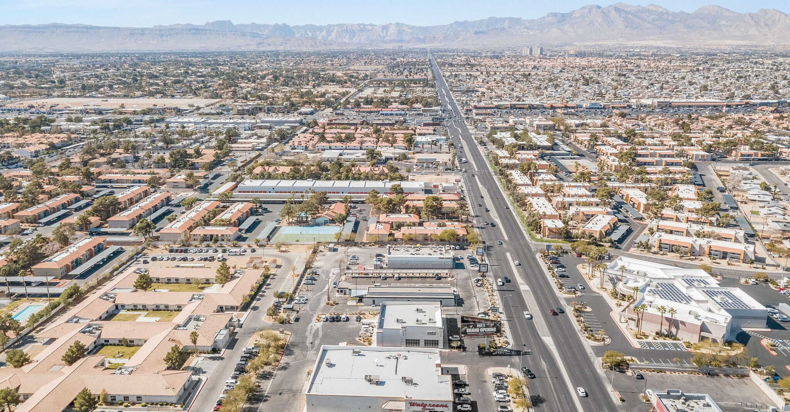

Assembly Bill 530
Roadway Funding
Extends FRI by 10 years
Retains vote of the people
Requires 2/3 majority of County Commission

Slide 30
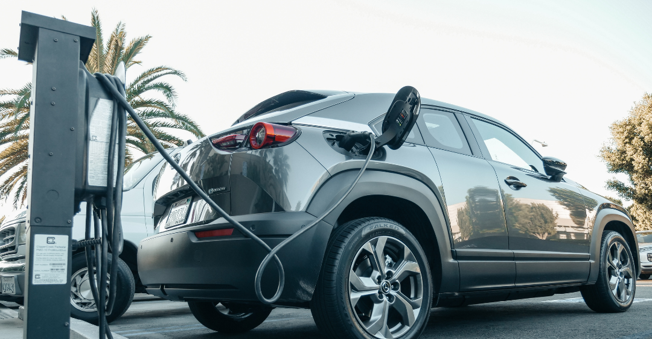
What Are Future Funding Options?

Slide 31
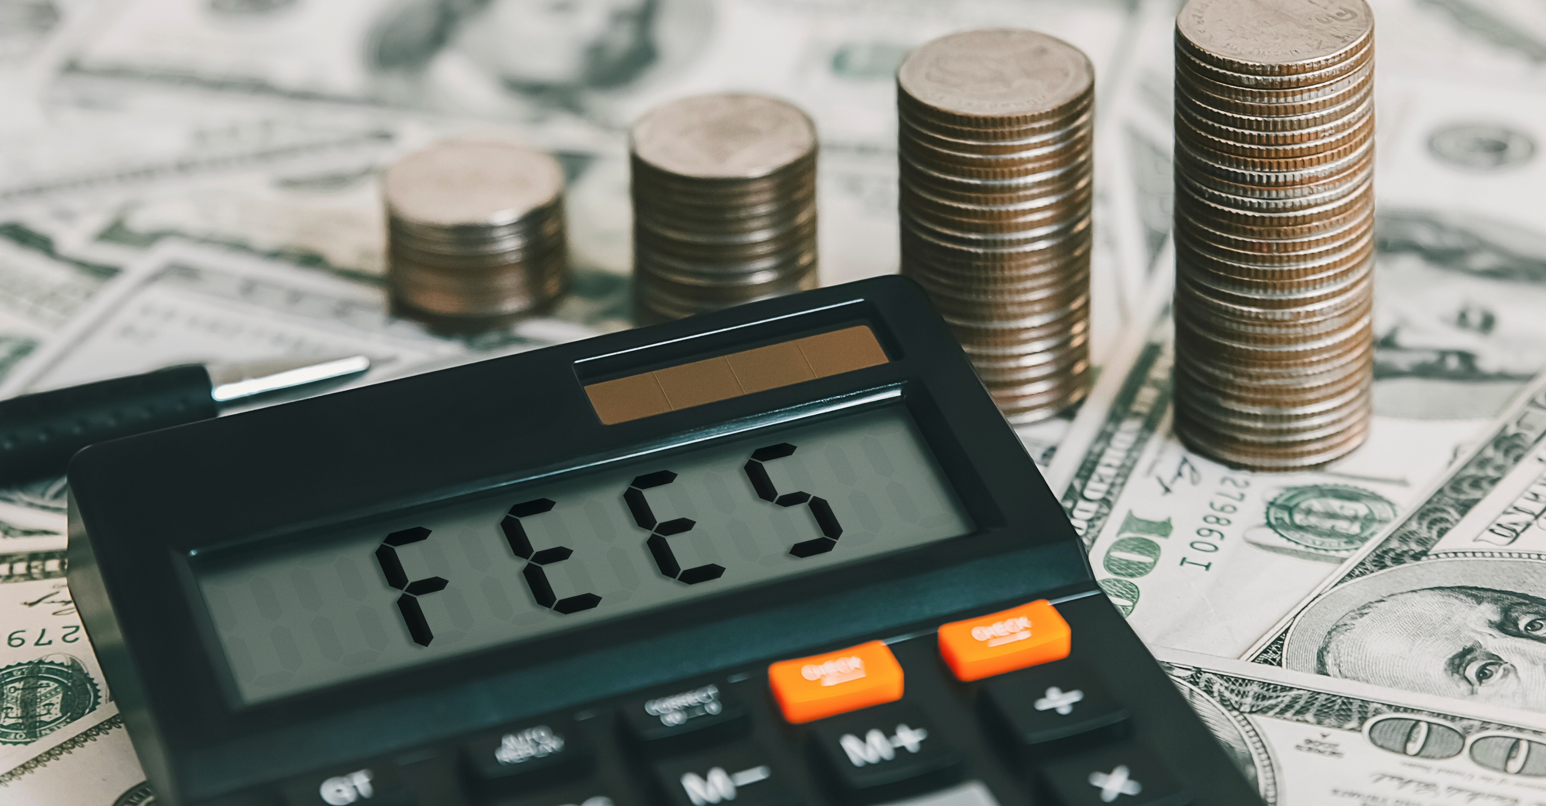
Other Funding Options
Electric/Hybrid Vehicle Fee
Road Usage Fee
Congestion Charge
Alternative Conveyance Fee
Delivery Fee
Transit Fare Increase
Sales Tax Increase

Slide 32

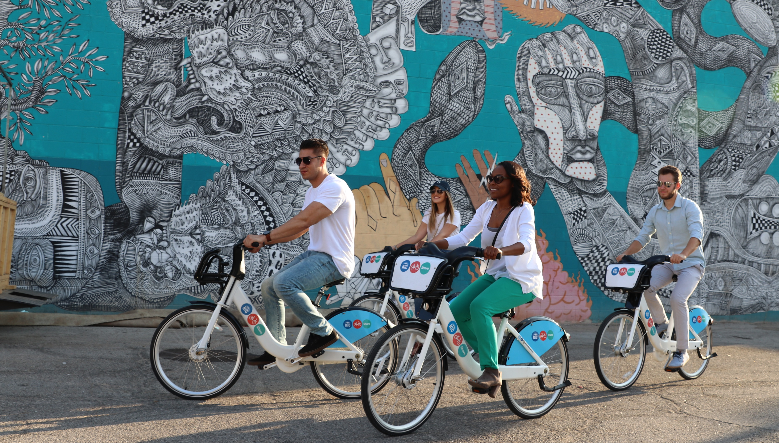
WE’RE GOING PLACES. LET’S GO TOGETHER
We put the
‘fun’ in funding.
F’ yeah!

